Slide 1
220208 발표자료
2018110654 이해님

Slide 2
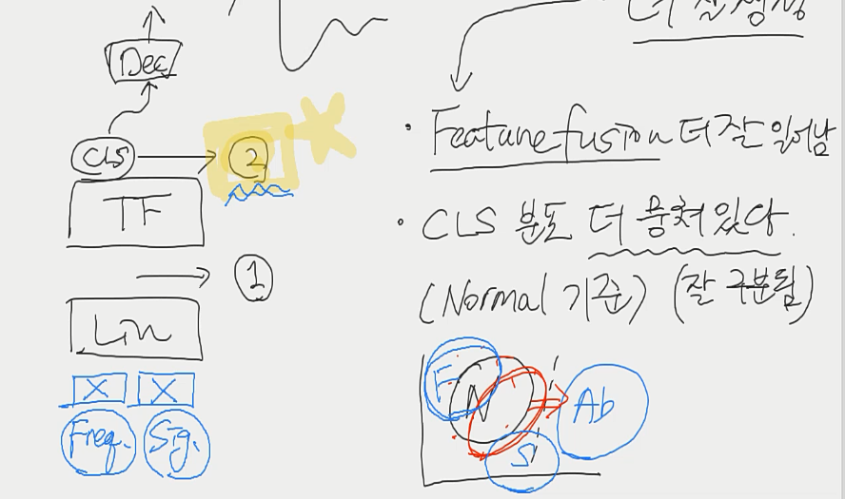
Comments
- PE 효과 없으면 제외
- T-SNE
2번에서 T-SNE를 찍어봤을 때 의의
Freq만, signal만 사용했을 때에 비해 이상적인 노말 분포로 이동한다는 것을
시각적으로 보여줄 수 있음

Slide 3
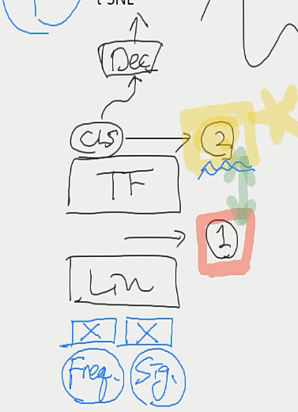
Comments
T-SNE
1번에서 찍었을 때와 2번에서 찍었을 때 분포 차이를 구하면 transformer의 효과를 보여줄 수 있음
1번에서 어떻게 추가적인 분석이 가능할 지 아이디어 생각

Slide 4
Comments
논문 서술 방향
Prob #1) 기존 연구 제약 존재
- 정보가 부족
Prob #2) 어떻게 fusion을 하냐
- linaer => concat 보다 concat => linear 을 발견
- transformer를 중간에 넣어 feature fusion

Slide 5
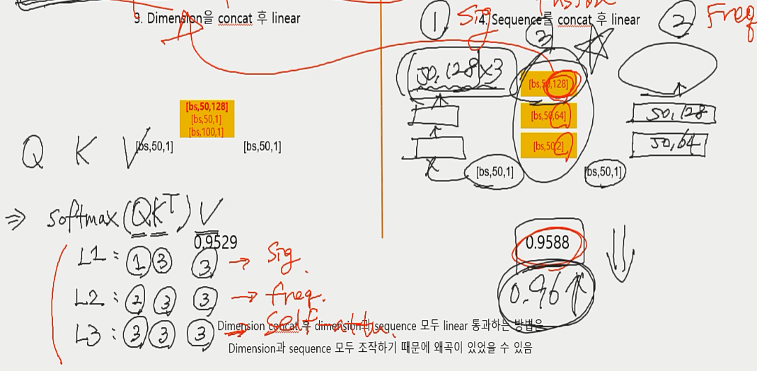
Comments
Attention 방법
1. QKV 변경
2. HEAD 이용
3. 3번 피처만 가지고 어떻게 attention할 수 있을 지 생각

Slide 6
Comments
Half-attention
반만 masking하는 방법으로 변경
기존 코드와 masking 방법 코드 가져오기
- CLS 평균으로 signal 생성
Signal의 평균으로 signal 생성
평균 => 다른방법

Slide 7



signal 평균 모델
Generated
Signal
평균
Generated
Signal1
Generated
Signal1
[bs,1,320]
Disc
[bs,50(D),1(CLS)]
transformer
$$⋮$$
transformer
[bs,50(D),256(S)]
transformer
[bs,50(D),128(S)]
$$⋯$$
$$⋯$$
[bs,50(D),128(S)]
s
[bs,50,128]
[bs,50,64]
[bs,50,1]
[bs,50,128]
[bs,50,64]
[bs,50,2]
S+F
[bs,50,1]
concat
[bs,50,1]
[bs,1,320]
Signal
Frequency
[bs,1,128,128]
Transform
(STFT)

Slide 8
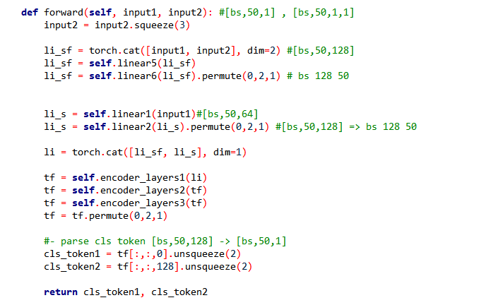
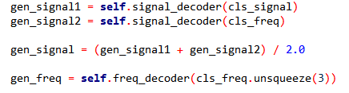



기존 코드 - transformer
Generated
Signal
평균
6
Generated
Signal1
Generated
Signal1
[bs,1,320]
1
Disc
5
2
[bs,50(D),1(CLS)]
transformer
3
$$⋮$$
4
transformer
4
[bs,50(D),256(S)]
transformer
[bs,50(D),128(S)]
$$⋯$$
$$⋯$$
[bs,50(D),128(S)]
3
2
s
[bs,50,128]
[bs,50,64]
[bs,50,1]
[bs,50,128]
[bs,50,64]
[bs,50,2]
S+F
5
1
[bs,50,1]
concat
[bs,50,1]
6
[bs,1,320]
Signal
Frequency
[bs,1,128,128]
Transform
(STFT)

Slide 9
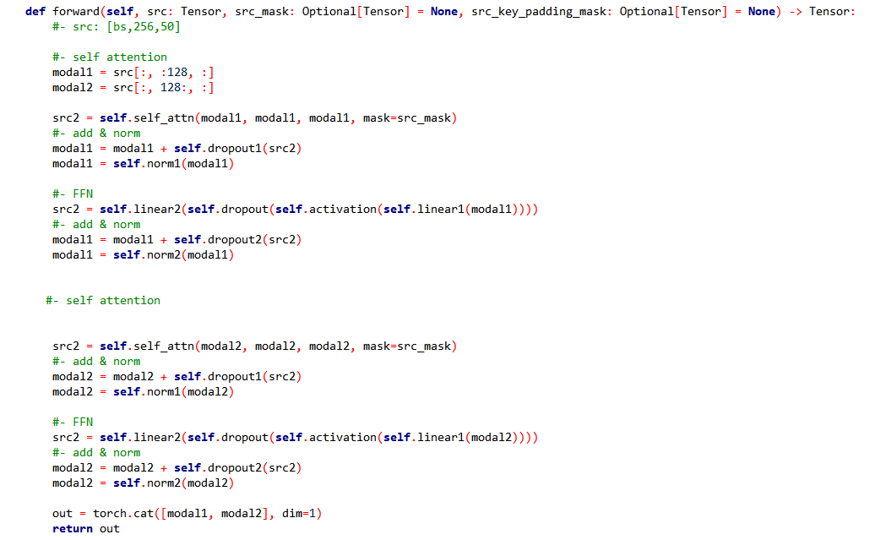


기존 코드 – transformer encoder layer
Disc
[bs,50(D),1(CLS)]
Q (s+f) K(s+f) V(s+f)
Q (s) K(s) V(s)
transformer
Q (s+f) K(s+f) V(s+f)
transformer
Q (s) K(s) V(s)
Q (s+f) K(s+f) V(s+f)
transformer
Q (s) K(s) V(s)
$$⋯$$
$$⋯$$
[bs,50(D),256(S)]

Slide 10



Masking 방법으로 변경
Generated
Signal1
Generated
Signal2
[bs,1,320]
Disc
Q (s+f) K(s+f) V(s+f)
[bs,50(D),1(CLS)]
Q (s) K(s) V(s)
transformer
$$⋮$$
Q (s+f) K(s+f) V(s+f)
Q (s) K(s) V(s)
transformer
transformer
Q (s+f) K(s+f) V(s+f)
$$⋯$$
$$⋯$$
Q (s) K(s) V(s)
[bs,50(D),256(S)]

Slide 11
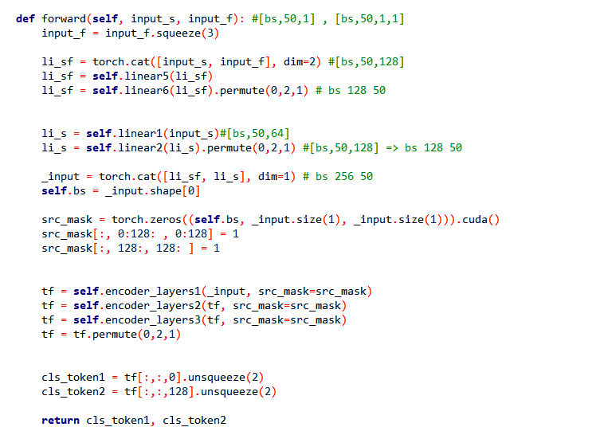
Masking 방법으로 변경
128
128
sf key
s key
sf query
128
0
128
0
s query
256 x 256
256 x 256
Masking matrix
Attention score

Slide 12
바꾼 코드 – transformer
Generated
Signal
평균
6
Generated
Signal1
Generated
Signal1
1
[bs,1,320]
2
Disc
5
3
[bs,50(D),1(CLS)]
bs, 256, 256
transformer
$$⋮$$
4
transformer
[bs,50(D),256(S)]
transformer
4
[bs,50(D),128(S)]
$$⋯$$
$$⋯$$
[bs,50(D),128(S)]
3
2
s
[bs,50,128]
[bs,50,64]
[bs,50,1]
[bs,50,128]
[bs,50,64]
[bs,50,2]
S+F
1
5
[bs,50,1]
concat
[bs,50,1]
6
[bs,1,320]
Signal
Frequency
[bs,1,128,128]
Transform
(STFT)

Slide 13
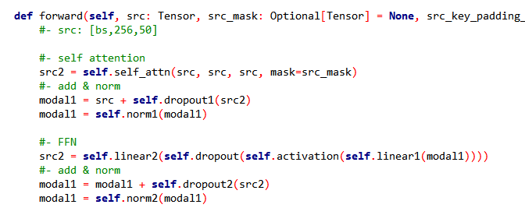
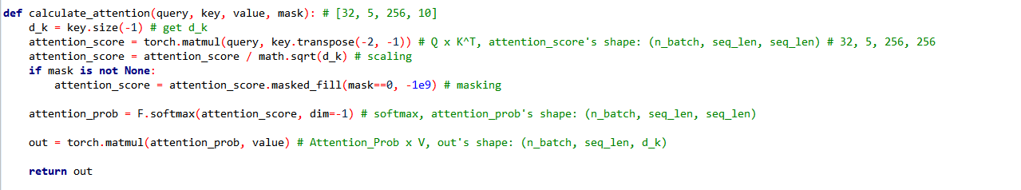


바꾼 코드 – transformer encoder layer
Disc
[bs,50(D),1(CLS)]
Q (s+f) K(s+f) V(s+f)
Q (s) K(s) V(s)
transformer
Q (s+f) K(s+f) V(s+f)
transformer
Q (s) K(s) V(s)
Q (s+f) K(s+f) V(s+f)
transformer
Q (s) K(s) V(s)
$$⋯$$
$$⋯$$
[bs,50(D),256(S)]
MultiHeadAttentionLayer

Slide 14


1. 마스킹 방법1
128
sf key
s key
sf query
128
Q (s+f) K(s+f) V(s+f)
Q (s) K(s) V(s)
Q (s+f) K(s+f) V(s+f)
Q (s) K(s) V(s)
Q (s+f) K(s+f) V(s+f)
Q (s) K(s) V(s)
s query
[bs,50(D),128(S)]
$$⋯$$
$$⋯$$
[bs,50(D),128(S)]
256 x 256
Attention score
AUC: 0.8125

Slide 15
2. 마스킹 방법2
128
sf key
s key
sf query
128
Q (s+f) K(s+f) V(s+f)
Q (s) K(s+f) V(s+f)
Q (s+f) K(s+f) V(s+f)
Q (s) K(s+f) V(s+f)
Q (s+f) K(s+f) V(s+f)
Q (s) K(s+f) V(s+f)
s query
[bs,50(D),128(S)]
$$⋯$$
$$⋯$$
[bs,50(D),128(S)]
256 x 256
Attention score
AUC: 0.9106

Slide 16
3. 마스킹 방법3
128
sf key
s key
sf query
128
Q (s+f) K(s) V(s)
Q (s) K(s) V(s)
Q (s+f) K(s) V(s)
Q (s) K(s) V(s)
Q (s+f) K(s) V(s)
Q (s) K(s) V(s)
s query
[bs,50(D),128(S)]
$$⋯$$
$$⋯$$
[bs,50(D),128(S)]
256 x 256
Attention score
AUC: 0.9142

Slide 17
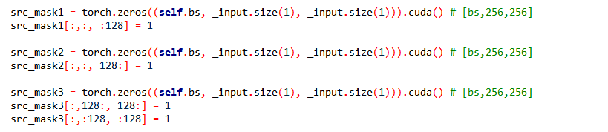
4. 마스킹 방법4
sf key
s key
sf query
s query
Q (s+f) K(s+f) V(s+f)
Q (s) K(s) V(s)
sf key
s key
Q (s+f) K(s) V(s)
Q (s) K(s) V(s)
sf query
Q (s+f) K(s+f) V(s+f)
Q (s) K(s+f) V(s+f)
s query
[bs,50(D),128(S)]
$$⋯$$
$$⋯$$
[bs,50(D),128(S)]
sf key
s key
sf query
AUC: 0.8581
s query

Slide 18

기존 CLS 토큰 평균 모델
Generated
Signal1
6
[bs,1,320]
1
Disc
평균
2
5
[bs,50(D),1(CLS)]
transformer
3
$$⋮$$
4
transformer
4
[bs,50(D),256(S)]
transformer
[bs,50(D),128(S)]
$$⋯$$
$$⋯$$
[bs,50(D),128(S)]
3
2
s
[bs,50,128]
[bs,50,64]
[bs,50,1]
[bs,50,128]
[bs,50,64]
[bs,50,2]
S+F
5
1
[bs,50,1]
concat
[bs,50,1]
6
[bs,1,320]
Signal
Frequency
[bs,1,128,128]
Transform
(STFT)

Slide 19



변경된 CLS 토큰 평균 모델
Generated
Signal1
6
[bs,1,320]
1
2
Disc
평균
5
3
[bs,50(D),1(CLS)]
bs, 256, 256
transformer
$$⋮$$
4
transformer
[bs,50(D),256(S)]
transformer
4
[bs,50(D),128(S)]
$$⋯$$
$$⋯$$
[bs,50(D),128(S)]
3
2
s
[bs,50,128]
[bs,50,64]
[bs,50,1]
[bs,50,128]
[bs,50,64]
[bs,50,2]
S+F
1
5
[bs,50,1]
concat
[bs,50,1]
[bs,1,320]
Signal
Frequency
[bs,1,128,128]
6
Transform
(STFT)

Slide 20
1. 마스킹 방법1
128
sf key
s key
sf query
128
Q (s+f) K(s+f) V(s+f)
Q (s) K(s) V(s)
Q (s+f) K(s+f) V(s+f)
Q (s) K(s) V(s)
Q (s+f) K(s+f) V(s+f)
Q (s) K(s) V(s)
s query
[bs,50(D),128(S)]
$$⋯$$
$$⋯$$
[bs,50(D),128(S)]
256 x 256
Attention score
AUC: 0.9387

Slide 21
2. 마스킹 방법2
128
sf key
s key
sf query
128
Q (s+f) K(s+f) V(s+f)
Q (s) K(s+f) V(s+f)
Q (s+f) K(s+f) V(s+f)
Q (s) K(s+f) V(s+f)
Q (s+f) K(s+f) V(s+f)
Q (s) K(s+f) V(s+f)
s query
[bs,50(D),128(S)]
$$⋯$$
$$⋯$$
[bs,50(D),128(S)]
256 x 256
Attention score
AUC: 0.9290

Slide 22
결과표
모델 | Attention 종류 | 기존 방식 AUC | Masking 방식 AUC
Signal의 평균으로 signal 생성 | 방법1 – self | 0.8988 | 0.8125
기존 | 방법2 – sf | 0.8758 | 0.9106
 | 방법3 – s | - | 0.9142
 | 방법4 - mix | - | 0.8581
CLS 토큰의 평균으로 signal 생성 | 방법1 – self | 0.9352 | 0.9387
 | 방법2 – sf | 0.9262 | 0.9290
 | 방법3 – s | - | -
 | 방법4 - mix | - | -

Slide 23




기타 마스킹 방법
s key
f key
Q (f) K(f) V(f)
Q (s) K(s) V(s)
s query
Q (f) K(f) V(f)
Q (s) K(s) V(s)
f query
Q (f) K(f) V(f)
Q (s) K(s) V(s)
[bs,50(D),128(S)]
$$⋯$$
$$⋯$$
[bs,50(D),128(S)]
s key
f key
Q (f) K(s) V(s)
Q (s) K(f) V(f)
s query
Q (f) K(s) V(s)
Q (s) K(f) V(f)
f query
Q (f) K(s) V(s)
Q (s) K(f) V(f)
[bs,50(D),128(S)]
$$⋯$$
$$⋯$$
[bs,50(D),128(S)]

